Slide 1
Attacking and Defending
Cybersecurity Boot Camp
Lesson 1.2

Slide 2

By the end of today’s class, you will be able to:
1
Understand the security mindset.
2
List different types of user, web, server, and database cybersecurity attacks.
3
Identify risk mitigation plan frameworks for these attacks.

Slide 4

The two concepts cybersecurity are centered on are:

Slide 5
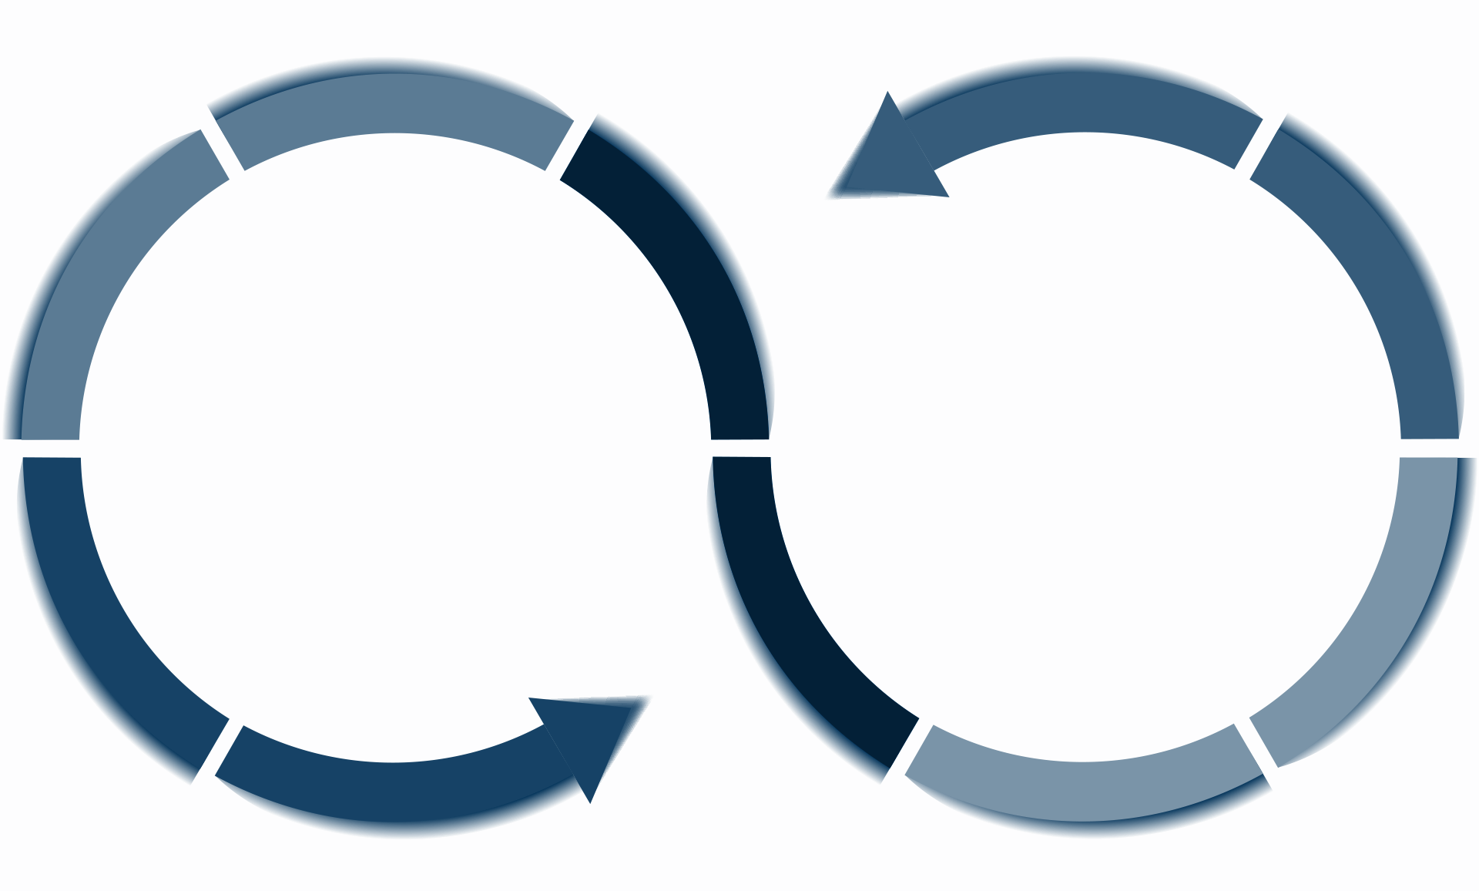
The two concepts cybersecurity are centered on are:
Threat assessment
Risk mitigation

Slide 6

Recap
Threat Assessment
Risk Mitigation
The central definitions of threat assessment and risk mitigation are:
The structured process of identifying the threats posed to a group or system
The systematic reduction of the impact or likely occurrence of a negative event

Slide 7

Recap:
In other words…
Threat assessment:
What could happen?
Risk mitigation:
How do we handle it?

Slide 8
Why do we use the term “mitigation” and not “eradication”?

Slide 9
Mitigation, not eradication:
We cannot eradicate all risks.
Cybersecurity is an ever-evolving landscape.

Slide 11
Today’s Class
We will continue with assessing threats and mitigating risks by evaluating specific attacks and vulnerabilities associated with:
Users
Web applications
Servers
Databases

Slide 12

Think like offensive and defensive cybersecurity professionals

Slide 13



Activity:
Security Task #1
Suppose you have found an unattended iPhone left at a table in a restaurant.
The iPhone is not locked with a password, and every feature and app
is accessible.
As a class, let’s identify as many exploits as possible that could result from a stolen cell phone.
Hint: Be creative! Think like an attacker.
What is the worst possible damage that could happen?
Think about real damage.
Think beyond the value of the phone itself.
Suggested Time:
20 minutes

Slide 15
Quick Review
Oh look, a phone!
Potential Adverse Events
The phone is wiped and resold.
Phone memory is harvested and photos and sensitive material are used for blackmail.
Credentials for email and social media accounts are used to extract financial gain.
Installed applications are used to make purchases.
Malware software is directly installed to track future activity.
Phone contacts are socially engineered to provide money.
The phone is used to conduct illegal activity.
The owner’s identity is stolen.

Slide 16

Security Task #2
Attacking the Wall
Congratulations! You have been hired by Bitcoin Dating Exchange.
While their founding team is brilliant, like
many startups, they don’t know the first thing
about security.
They just handed you a lot of money to solve their most critical problem.
Attackers are routinely logging in as users and administrators and gaining access to company data and financial assets.

Slide 17


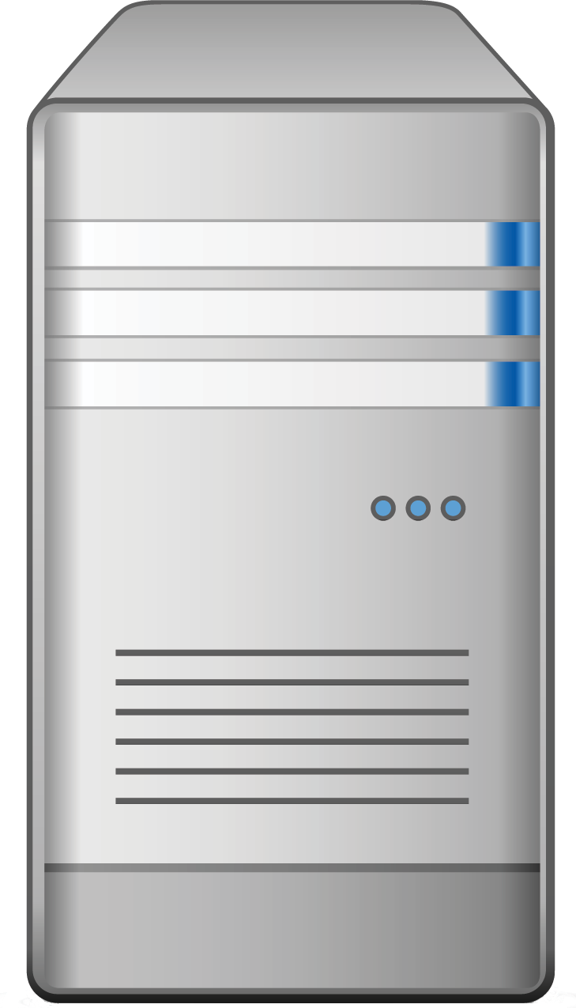

Activity: Security Task #2
Attacking the Wall
Web Logins 101
Login
Web Login
Server
Data
We’ll spend a lot more time talking about web logins later in this course, but for now we’ll use this diagram as a guide.
Users and Admins

Slide 18
Attacking the Wall
In groups, develop a list of 15 ways that a malicious actor could penetrate the system and log in as a user or administrator.
With each method, describe the following:
  Who (or what) is the initial target?
  How would the actor implement the attack?
20 Minutes

Slide 20
Activity: Security Task #2
Defining Attack Strategies
Brute force attack
Phishing
Keylogging
Session hijacking
Person-in-the-middle attack

Slide 21
Activity: Security Task #2
Defining Attack Strategies Cont.
Credential stuffing
SQL injection
Cross-site scripting
Exploiting outdated software
Social engineering

Slide 22

Defining Attack Strategies
Attack option #1: Brute force attack
An attacker can use a brute force attack to continuously attempt username and password combinations.
Username: bob@bbb.com Password: Love
Username: bob@bbb.com Password: Love123
Username: bob@bbb.com Password: Love123!
Username: bob@bbb.com Password: L@ve123
Login
Password dictionary

Slide 23
Defining Attack Strategies
Attack option #2: Phishing
An attacker can attempt a phishing attack, where users are redirected to fake login pages that capture user credentials.
Fake login
Login
Login

Slide 24

Defining Attack Strategies
Attack option #3: Keylogging
An attacker can deploy malware such as keyloggers to capture daily user activity.
Login
Keylogger

Slide 25
Defining Attack Strategies
Attack option #4: Stolen hardware
An attacker can simply exploit a valid computer session to gain unauthorized access to information or services.
Login
Computer left open

Slide 26
Defining Attack Strategies
Attack option #5: Person-in-the-middle attack
An attacker can create a person-in-the-middle attack by providing a free WiFi hotspot to capture user credentials.
WiFi
Login
Shady WiFi

Slide 27
Defining Attack Strategies
Attack option #6: Credential stuffing
An attacker can find and steal users’ login and password information from other websites to gain unauthorized access to a system.
Login
Recycled password
Login
Login

Slide 28
Defining Attack Strategies
Attack option #7: SQL injection
An attacker can use a code-injection attack to inject malicious code directly into username or password fields.
Username:
uName = getRequestString("username");
uPass = getRequestString("userpassword");
sql = 'SELECT * FROM Users WHERE Name ="' + uName + '" AND Pass ="' + uPass + '"'
Login
Password dictionary

Slide 29
Defining Attack Strategies
Attack option #8: Cross-site scripting (XSS)
An attacker can inject malicious scripts into web pages viewed by other users and use these as a backdoor into their systems.
Login
Malware

Slide 30
Defining Attack Strategies
Attack option #9: Exploiting outdated software
Attackers can use known vulnerabilities in outdated software to breach security.
Vulnerable machine
Data

Slide 31
Defining Attack Strategies
Attack option #10: Social engineering
An attacker can ask users for their credentials by pretending to be an administrator.
Fake admin

Slide 34

Security Task #3
Defending the Wall
In the same groups, you will now use your list of potential attacks from the previous activity to develop a list of at least 10 strategies to mitigate the website’s risk.
As you work through this scenario, consider the following:
Can any mitigation strategies be used to handle multiple threads at once?
Notes:
shutterstock_1095422036

Slide 35
Defending the Wall
Now that we’ve assembled a list of potential attacks, your next task is to develop a list of at least 10 strategies to mitigate the website’s risk of unauthorized access. Be prepared to share!
20 Minutes

Slide 37
Risk Mitigation Plan
Potential Defenses
01
Strong password policies
02
Phishing training programs
03
Anti-keylogging software
04
Session management security
05
Encryption

Slide 38
Risk Mitigation Plan
Potential Defenses
06
Multi-factor authentication (MFA)
07
Regular security audits
08
Software and patch management
09
Employee security training
10
Advanced intrusion detection systems

Slide 39
Effective risk mitigation strategies can address multiple threats at once.

